Slide 1
Activating Parents and Community Members to Advocate for Public Schools
2017 ISFIS, Inc. Conference

Slide 2
What’s your starting point?
What is the current relationship between your school district and your elected officials?
Do your parents and community understand how the state legislature’s actions affect schools?

Slide 3
Parents for Great Iowa Schools
Rose Green, founder
www.parentsforgreatiowaschools.com
Facebook.com/parentsforgreatiowaschools
Grassroots
Social media
Meetings on location
Work with lobbyists from UEN, RSAI, IASB, SAI

Slide 4
Parents for Great Iowa Schools
Guiding Principal + Values
Non-partisan
Student-focused
Informed
Action Oriented
Priorities 2017 legislative session
1) SSA
2) ESAs
Proactive between legislative sessions

Slide 5
DMPS Legislative Action Team
Cindy Elsbernd, Des Moines School Board
Louisa Dykstra, parent on steering committee
School Board led Parents – Board – Administration – Lobbyists
Facebook.com/DMPSCommLegisAction
2017 legislative priorities
SAVE
Pre-K
ELL

Slide 6
How to get Parents Engaged
Understand what a difference they can make
Voice heard more than administrators/teachers
Small numbers who build relationships make a difference!!
Educate and Empower
How to connect with legislators
What your district needs
Use your resources: UEN, IASB, SAI, etc. to help parents be most effective

Slide 7
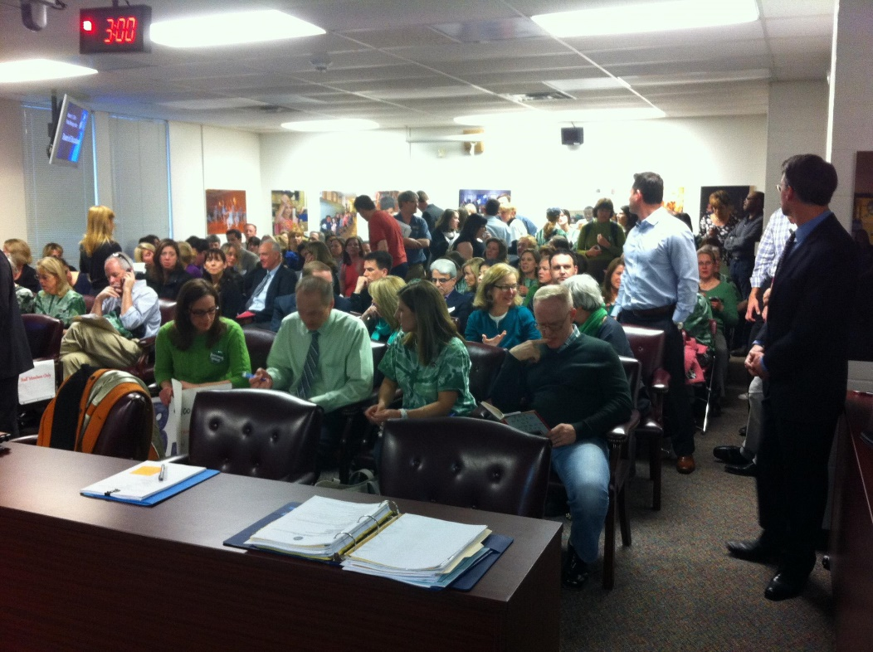
What will work for you?
What are your district’s priorities?
Write down top two
Five people
Parents/community/ business
Active, non-confrontational
Notes:
By the time the school board is making funding decisions, the water isn’t just under the bridge, it’s way downstream. The school board is reacting to the funding level the state legislature has set.
Taking action earlier, when the state legislature is voting on funding, has the power to get our district the resources they need to preserve programs.

Slide 8
What will work for you?
How are your district’s priorities personal for the five people you named?
What’s the easiest method for you to activate?
Committee?
Emails? Phone?
Long-term game goal is moving the needle with conversations
Notes:
By the time the school board is making funding decisions, the water isn’t just under the bridge, it’s way downstream. The school board is reacting to the funding level the state legislature has set.
Taking action earlier, when the state legislature is voting on funding, has the power to get our district the resources they need to preserve programs.

