Slide 1
June 2018
Comprehensive Financial Projection Model
ISFIS / Piper Jaffray Project
Travis Squires
Larry Sigel
Managing Director
Partner
Tel: +1 515 247-2354
Tel: +1 515 251-5970
Email: travis.r.squires@pjc.com
Email: larry.sigel@isfis.net

Slide 2
Disclosure
Piper Jaffray is providing the information contained herein for discussion purposes only in anticipation of being engaged to serve as underwriter or placement agent on a future transaction and not as a financial advisor or municipal advisor. In providing the information contained herein, Piper Jaffray is not recommending an action to you and the information provided herein is not intended to be and should not be construed as a “recommendation” or “advice” within the meaning of Section 15B of the Securities Exchange Act of 1934. Piper Jaffray is not acting as an advisor to you and does not owe a fiduciary duty pursuant to Section 15B of the Exchange Act or under any state law to you with respect to the information and material contained in this communication. As an underwriter or placement agent, Piper Jaffray’s primary role is to purchase or arrange for the placement of securities with a view to distribution in an arm’s-length commercial transaction, is acting for its own interests and has financial and other interests that differ from your interests. You should discuss any information and material contained in this communication with any and all internal or external advisors and experts that you deem appropriate before acting on this information or material.
The information contained herein may include hypothetical interest rates or interest rate savings for a potential refunding. Interest rates used herein take into consideration conditions in today’s market and other factual information such as credit rating, geographic location and market sector. Interest rates described herein should not be viewed as rates that Piper Jaffray expects to achieve for you should we be selected to act as your underwriter or placement agent. Information about interest rates and terms for SLGs is based on current publically available information and treasury or agency rates for open-market escrows are based on current market interest rates for these types of credits and should not be seen as costs or rates that Piper Jaffray could achieve for you should we be selected to act as your underwriter or placement agent. More particularized information and analysis may be provided after you have engaged Piper Jaffray as an underwriter or placement agent or under certain other exceptions as describe in the Section 15B of the Exchange Act.
Piper Jaffray Companies (NYSE: PJC) is a leading investment bank and asset management firm. Securities brokerage and investment banking services are offered in the U.S. through Piper Jaffray & Co., member SIPC and FINRA; in Europe through Piper Jaffray Ltd., authorized and regulated by the U.K. Financial Conduct Authority; and in Hong Kong through Piper Jaffray Hong Kong Limited, authorized and regulated by the Securities and Futures Commission. Asset management products and services are offered through five separate investment advisory affiliates―U.S. Securities and Exchange Commission (SEC) registered Advisory Research, Inc., Piper Jaffray Investment Management LLC, PJC Capital Partners LLC and Piper Jaffray & Co., and Guernsey-based Parallel General Partners Limited, authorized and regulated by the Guernsey Financial Services Commission.
© 2018 Piper Jaffray Companies. 800 Nicollet Mall, Suite 1000, Minneapolis, Minnesota 55402-7036

Slide 3
Piper Jaffray -- Guiding Principles
We create and implement superior financial solutions for our clients. Serving clients is our fundamental purpose.
We earn our clients' trust by delivering the best guidance and service. Great people working together as a team are our competitive advantage.
As we serve, we are committed to these core values:
Always place our clients' interests first
Conduct ourselves with integrity and treat others with respect
Work in partnership with our clients and each other
Maintain a high quality environment that attracts, retains and develops the best people
Contribute our talents and resources to serve the communities in which we live and work

Slide 4
Table of Contents
Introductions
Overview of the Model
Preparing your Individual Model
Tour of the Model
Summary & Wrap Up

Slide 5
Section II: Overview of the Model
Background
Launched in June of 2016 as a joint project between Piper Jaffray & ISFIS
Both groups have been doing “Aid & Levy” projects for years
Wanting to provide schools with a project model that was:
Easy to Use
Accurate
Robust
Inexpensive*
*Downloadable Model is available free for Piper Jaffray clients and ISFIS subscribers. Hourly consulting fees apply. Premium model available with added features and includes one-on-one consulting time via webinar.

Slide 6
Section II: Overview of the Model
Why Every District Needs Some Form of 5 Year Projection
Provides time to make difficult decisions before they become a crisis
Are required by SBRC as part of any workout plan
Rating agencies want to see them
not just when completing new projects, but as part of annual review conference calls and interviews
Helps Boards explain to the public why the district is proceeding with it’s plan (i.e. budget reduction, tax rate changes, etc.)
Provides a “sense of urgency” to Board members for making decisions that will impact the long-term financial health of the District
Allows the district to manage (“plan”) the property tax rate

Slide 7
Section II: Overview of the Model
Recent Changes to the Model
A lot of changes over the past year…
Updated data
Summary and Charting options
Enhanced expenditure projection
Fund balance calculator refined
Data structure changes (under the hood)
Improved property tax rate accuracy (was already pretty good)
Enhanced property valuation forecast
Enhanced debt levy management planning
Additional statewide modeling flexibility
Commitment to Maintenance
Targeted Enhancements

Slide 8
Section III: Preparing Your Individual Model
Owning Your Assumptions
Establish Your Purpose for the Model
Your assumptions will be the key to the success of your Comprehensive Financial Planning Model
Notice that we did not say that accuracy of the assumptions, but the process of owning and understanding your assumptions
Key Assumption Metrics
SSA Rate (and other state level policy variables)
Enrollment
Special Education Deficit / Surplus (weightings will also be important if anticipated of changing headcount
Property Valuation Change
Expenditures Change
Miscellaneous Income
Needs in the Management Fund

Slide 9
Section IV: Tour of the Model
Navigation through the Model
Tabs are organized left to right (see checklist)
Similar to the Aid and Levy Worksheet (step by step projection)
Excel Based (plays nicer with Windows version of Excel)
No macros, however there are “data tables” (set calculation methodology)
Certain tabs illustrated in the Model are “Premium” feature

Slide 10
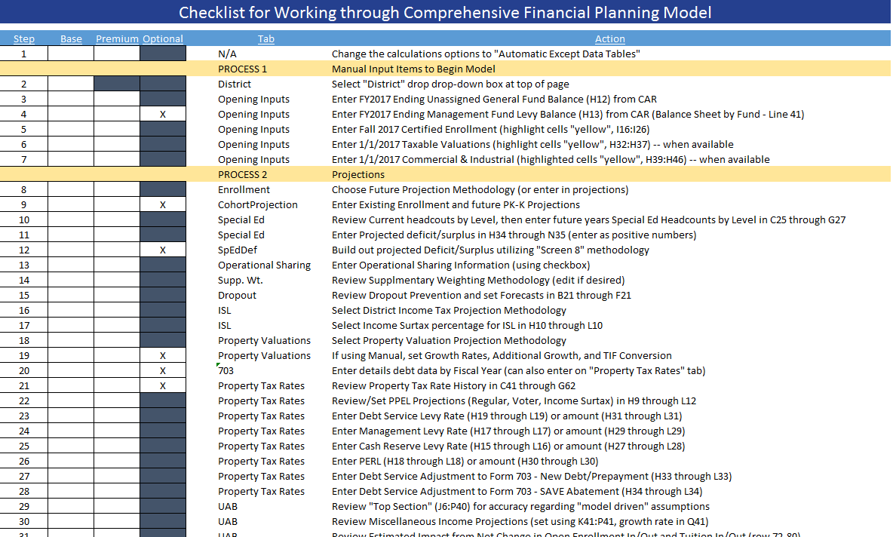
Section IV: Tour of the Model
Getting Started – Print the Checklist

Slide 11
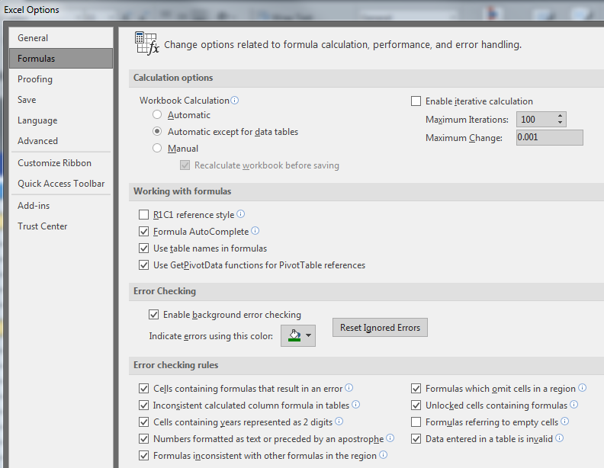
Section IV: Tour of the Model
Getting Started – Set your excel calculation options
Change calculation methodology to speed up model performance

Slide 12
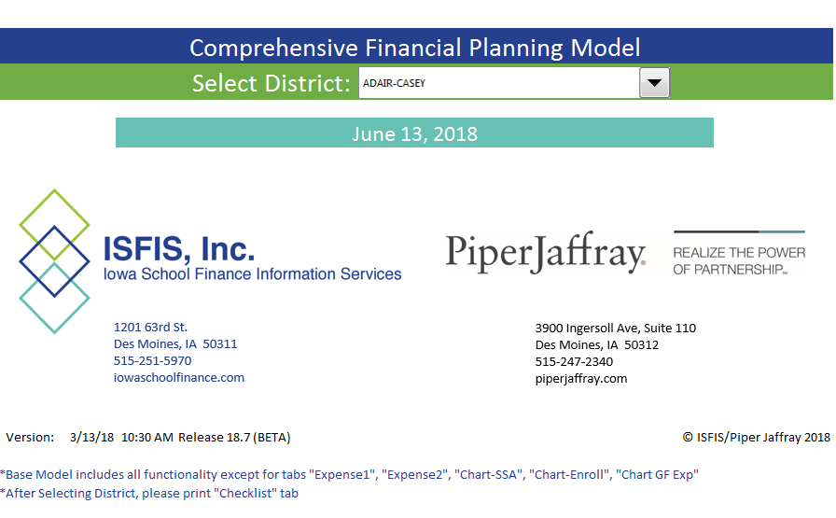
Section IV: Tour of the Model
Completing Your Model
Select your District and you are on your way…

Slide 13
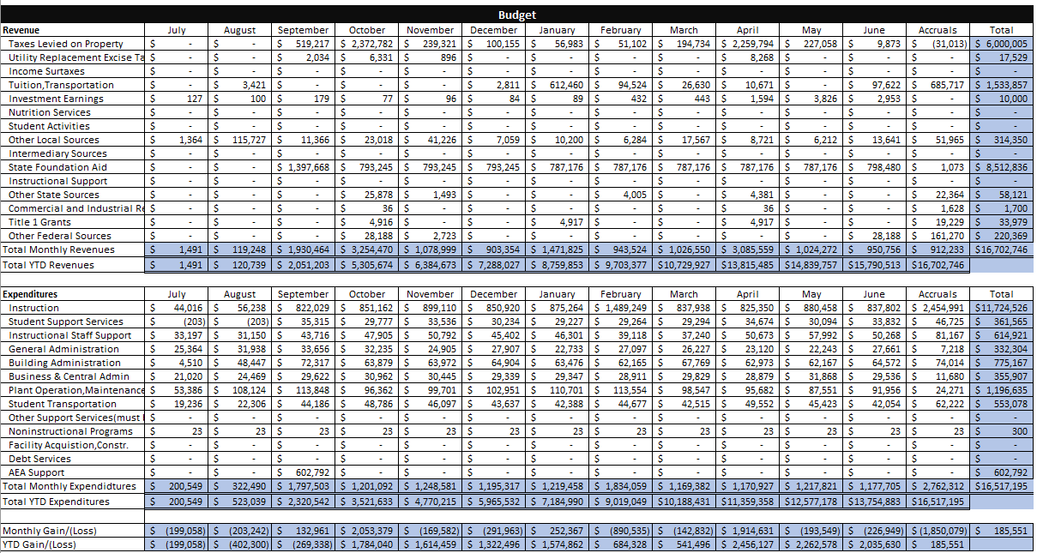
Section IV: Tour of the Model
Monthly Reporting Functionality
Build a budget…

Slide 14
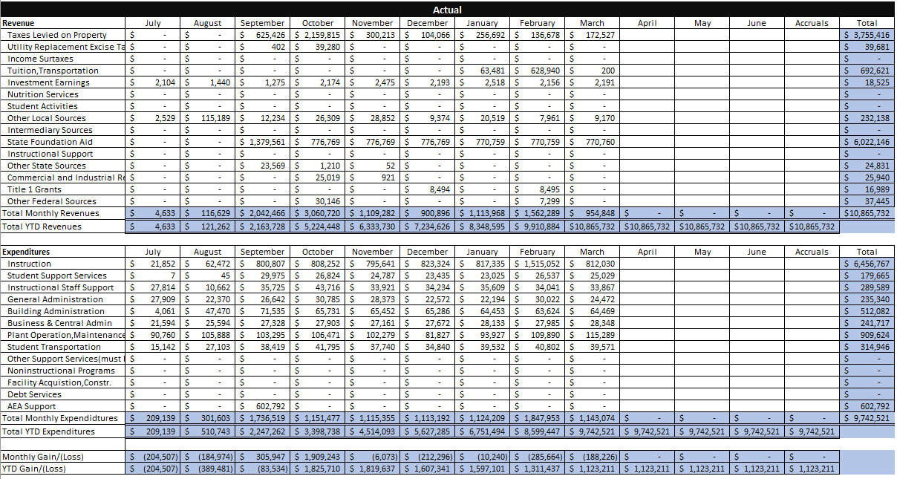
Section IV: Tour of the Model
Monthly Reporting Functionality
Enter your progress…

Slide 15
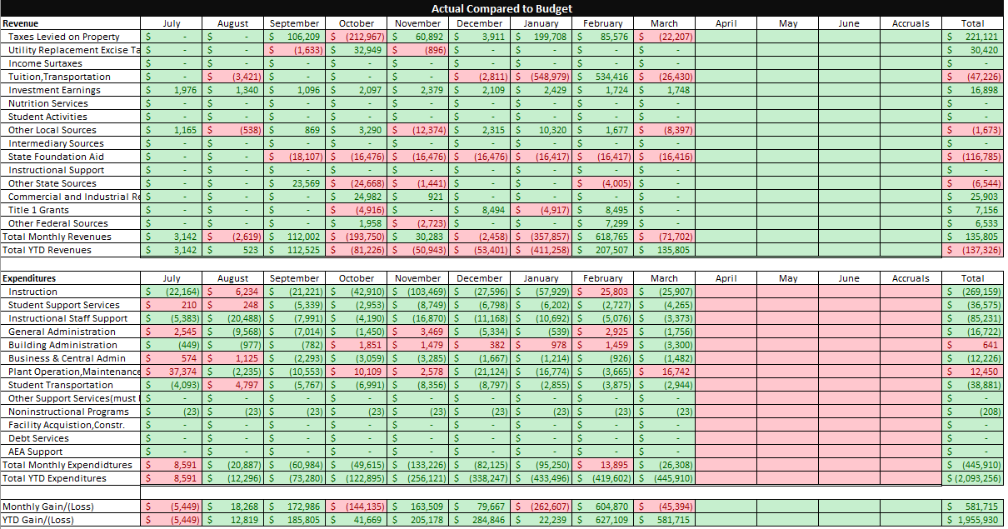
Section IV: Tour of the Model
Monthly Reporting Functionality
Review your progress…

Slide 16
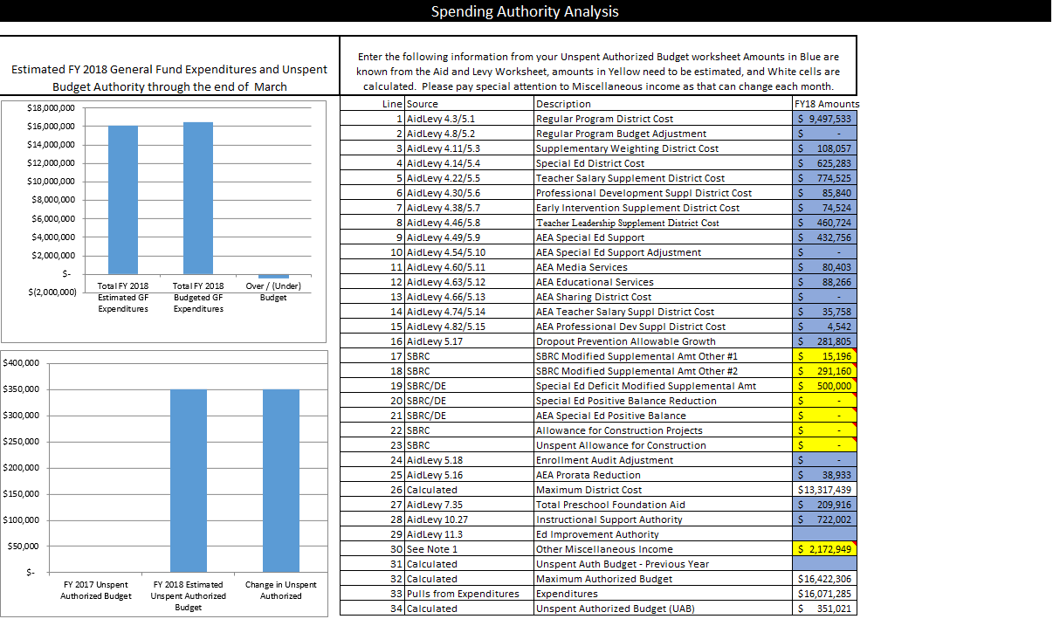
Section IV: Tour of the Model
Monthly Reporting Functionality
Manage your expectations…

Slide 17
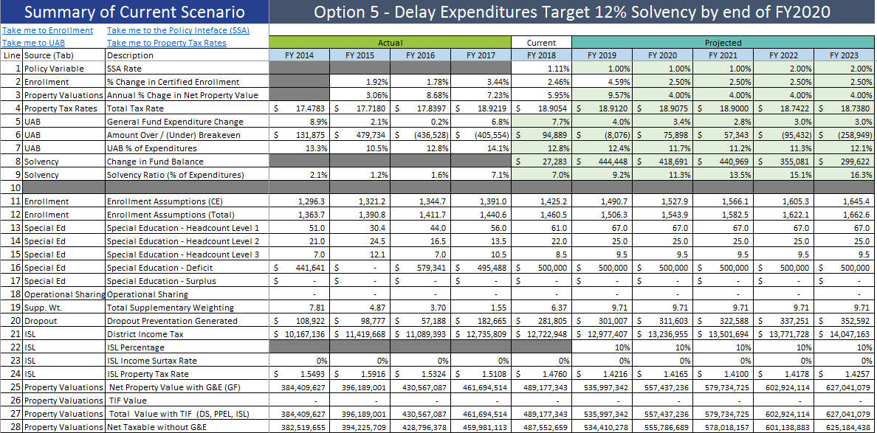
Section IV: Tour of the Model
Building Scenarios

Slide 18
Section V: Summary & Wrap Up
A Powerful Resource and Trusted Partners
Thanks for coming to the session
Let us know of your input and questions
Give us ideas about how we can make the tool more valuable for you

Slide 19
Questions?
Do not hesitate to contact us if you have any questions or comments
Iowa School Finance Information Services
Larry Sigel | larry.sigel@isfis.net | 515 251-5970 | 515-490-9951 (cell)
Piper Jaffray & Co.
Travis Squires | travis.r.squires@pjc.com | 515 247-2354
Matthew Gillaspie | matthew.r.gillaspie@pjc.com | 515 247-2353
Tim Oswald | timothy.j.oswald@pjc.com | 515 247-2358

