Slide 1
How We Got Into This Fiscal Pickle
Dave Swenson
Economics
Iowa State University

Slide 2
Sequence
This is not an auditing exercise – we’re going to work a bit through the historical process to where we are now
Current situation
How did we get here – a little fiscal history
Where does this leave us
What to do about it

Slide 3
Our Recent Predicament
Coming into the 2017 General Assembly, it had become apparent that earlier revenue forecasts were off … by a lot … more than $250 million less than forecast
Began the session with a $118 million cut to state spending – about 18 percent of which fell on public universities and community colleges in the second half of the fiscal year
Then added another $130 million from reserves to plug the gap
Magically they balanced the books at the end of Fiscal ‘17, but midway through FY ‘18 it was evident that mid-year cuts were necessary

Slide 4
Now
We’re looking at a massively reformed state tax system, the consequences of which unknown
Changes in tax structures, rates, and number of brackets
Broadening of the tax base to include on-line and “gig” categories
Bottom line – all heretofore fiscal stress notwithstanding, our state government will get smaller
There will be cuts

Slide 5
Then: A quick look at conditions in the 1980s

Slide 6
An Era of State Fiscal Stress Coupled with Fiscal Irresponsibility
In 1988, I’d written, in my review of the state, A DECADE OF ADJUSTMENT, “restatement of state revenues and expenditures … on a modified accrual basis indicates end-of-year deficits since 1983.”
By 1990, the cumulative fiscal imbalance was politically and practically intolerable – creation of the Governor’s Commission on Government Spending Reform – aka the Fisher Commission
Tasked with systematically overhauling the state’s revenue and expenditure accounting systems and implementing best practices

Slide 7
Selected Reforms
Implement GAAP accounting
Raise the sales tax by a penny to cover the accumulated deficit
Implemented a range of other spending and fiscal management reforms
Created the Revenue Estimating Conference – composed of one representative of the executive branch, the legislature, and a third member acceptable to both.
Limited fiscal year expenditures to 99 percent (recurring) or 95 percent (new revenues) of the December forecast

Slide 8
Early Reform Outcomes
Reforms enacted and implemented in earnest
Were aided by a booming economy – employment grew by a fifth during the decade – yielding a rapid recovery of state finances
By 1996, the state, flush with cash, began to consider tax cuts, and in 1998 cut all personal income tax rates by 10 percent
But all good times must end, and we slid into a recession in 2001 yielding a budgetary shortfall of $50.4 million– by 2002 Vilsack was looking $200 million cut in spending (and about 1,800 layoffs) followed by an expected $142 million shortfall in revenues in 2003

Slide 9
Nonetheless, Cutting Taxes or Not Collecting Taxes Became a Thing
As examples
Across the board tax cut in Branstad’s last term (just mentioned)
Sales tax exemption on non-profit hospitals
Utility taxes phased out under Vilsack
Social security incomes not taxed (and portions of pensions)
Military retirement incomes
Eventually large “tax expenditures” slowly accrued through
Economic development-linked tax breaks (under all administrations) to businesses
Research activity tax credits (and the supplemental)
Commercial and industrial property tax break (absorbed by the state)
Further sales tax reductions on manufacturers’ purchases
And now, across the board tax reform drastically lower state receipts

Slide 10
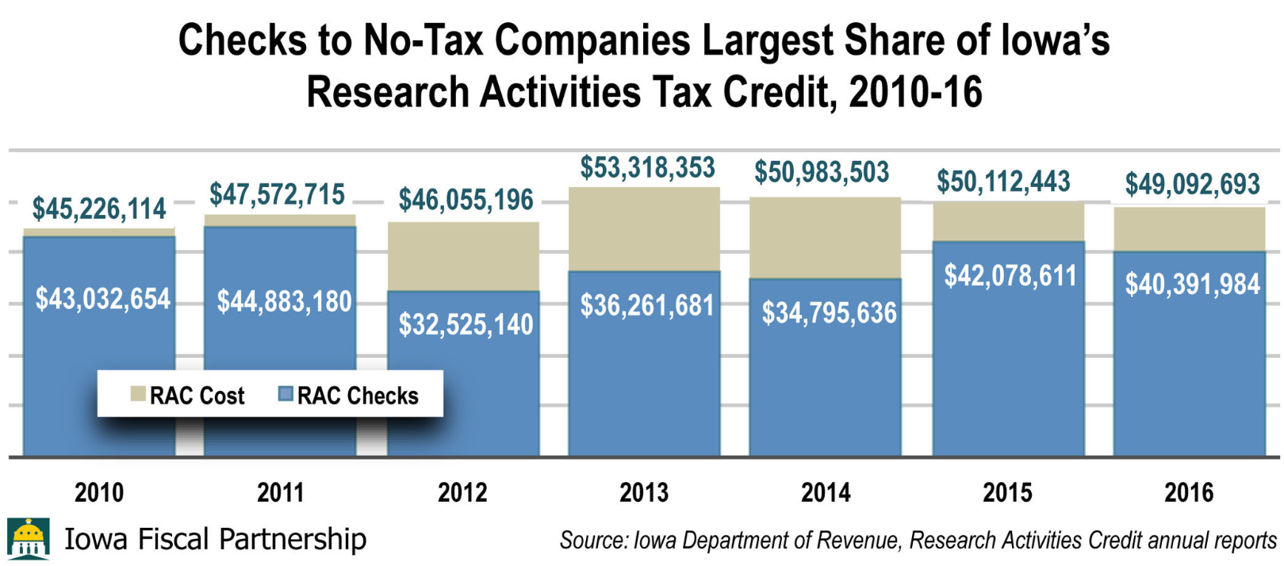
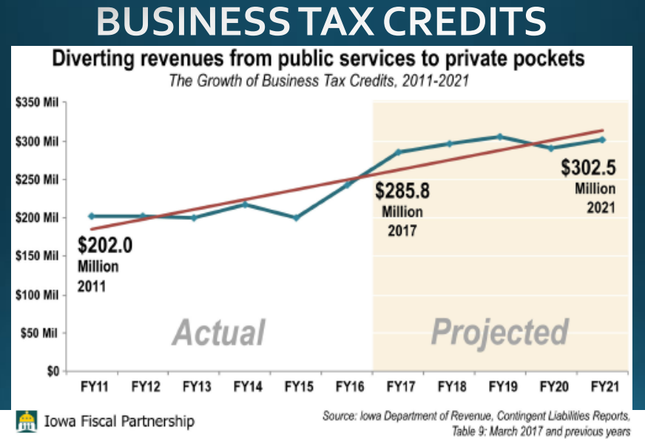
The Sum of Tax Cuts and Tax Expenditures Mounts: As Examples
RAC in 2017: $54.8 million, of which $41.8 million went to companies that owed no income taxes

Slide 11
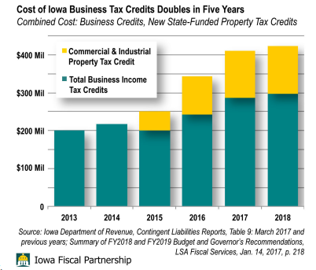
Plus Commercial and Manufacturing Property and Sales Tax Breaks
Coupled with sales tax breaks to manufacturers that were (probably) seriously under-estimated.
Conclusion: Continued expansion of business tax breaks coupled with incremental adjustments to what is and what is not taxable have constrained the state’s revenue flow

Slide 12
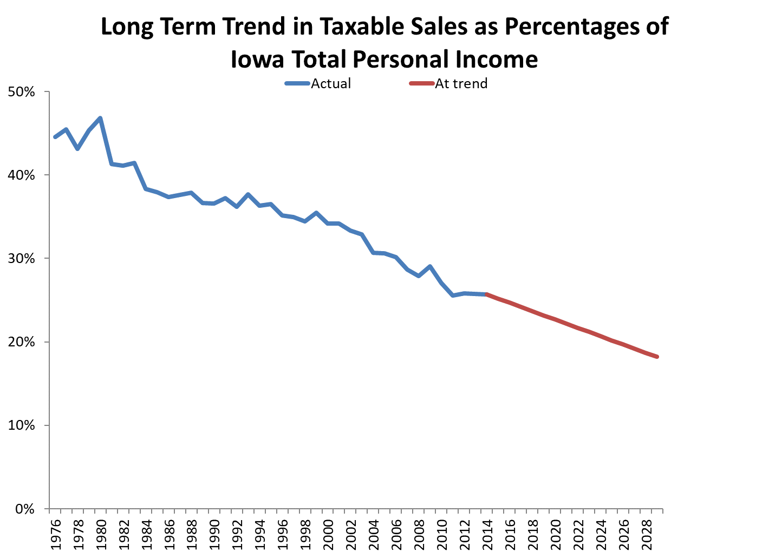
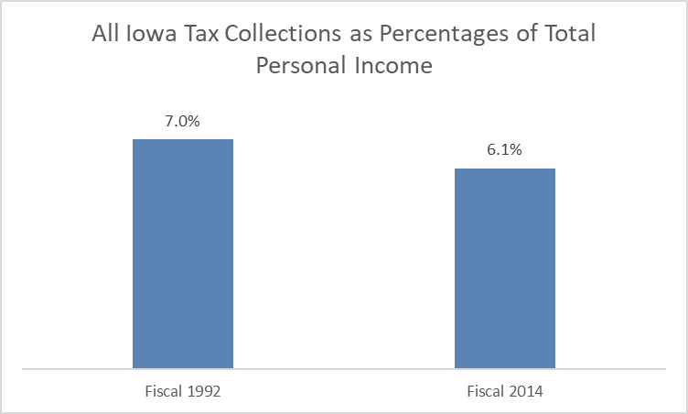
Plus, Overall Tax Incidences Have Decreased Over Time
If the state tax incidence has been the same in 2014 as in 1992, Iowa would have collected $1.17 billion more revenues

Slide 13
Reiterating the Aftermath
Harsh mid-course cuts in fiscal 2017
Additional transfers were needed to balance the budget at the end of the fiscal year
Fiscal ‘18 budget was ultimately proven unrealistic necessitating mid-year cuts and subsequent mid-session cuts
State’s revenue estimating process has proven to be extremely unreliable in recent years.

Slide 14
And More …
Notwithstanding the state’s inability to accumulate revenue to fully fund existing commitments, it has opted to reduce revenue flows further
With the newly signed tax reform package, state receipts would reduce by these amounts:
2019: $100.2 million
2020: $261.7 million
2021: $328.5 million
2022: $390.5 million
2023: $437.5 million if triggers are met
2024: $642.6 million if triggers are met

Slide 15
Iowa Income Performance

Slide 16
Where we are now
When we look at recent fiscal performance as well as huge cost unknowables (like Medicaid privatization costs to the state), one’s logical outlook would be gloomy. Especially considering the state’s recent economic performance and near term prospects.
But according to the Des Moines Register, one powerful legislator is fiscally optimistic:
Rep. Pat Grassley, R-New Hartford, said “he expects an ending balance of unspent funds totaling about $166 million in 2019 and about $328 million 2020.”

Slide 17
My Conclusions
Cumulative, the state is a victim of long-term legislative malpractice – tax cut and business incentive fever – a malady affecting nearly all state legislatures to some degree or another
There was (and is) knowable softness in the Iowa economy that was and continues to be misdiagnosed as it relates to fiscal performance
Executive malpractice, as well – obligation to maintain consistent fiscal integrity rests ultimately with the governor’s office
And
Unarguably botched fiscal ‘17 and (less so) fiscal ‘18 forecasts -- revenue estimating conference reform should be considered

Slide 18
Thank you dswenson@iastate.edu

